Slide 1
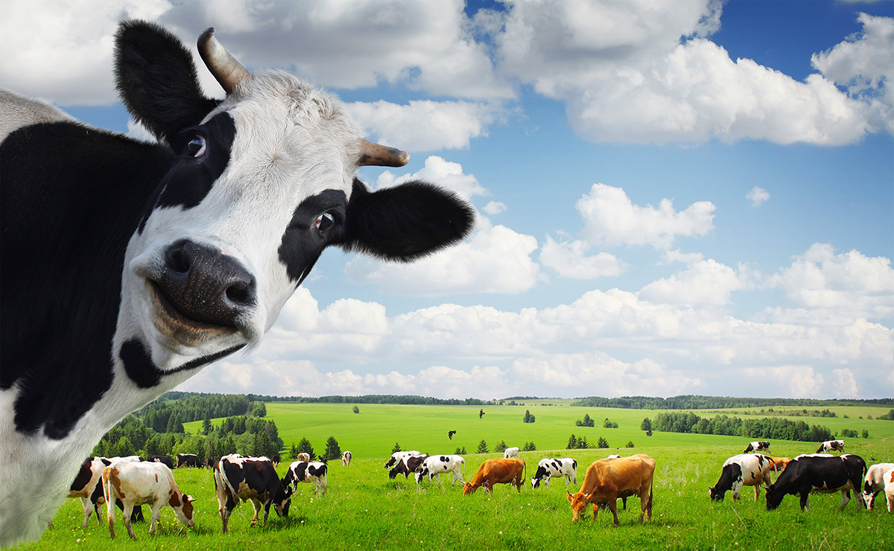
An Introduction to Herding Cows
By James Kilby @jameskilbynet
Notes:
Why herding cows?

Slide 2
About Me
Solution Engineer for North West Based ISP
Deploy solutions to our internal public cloud and AWS
Awarding vExpert 2015 & 2016
Working with VMware since early 2008 ESX(i) 3.5
Server Hugger

Slide 3
Why Automate ?
Intro
Notes:
Manual configurations
Custom Scripts
Golden Images
Snowflake Server >
Move to a desired state,……
Simulate changes…
Enforce
Compliance PCI DSS
Test enviroments exact replica
Push to dev before production Next slide

Slide 4
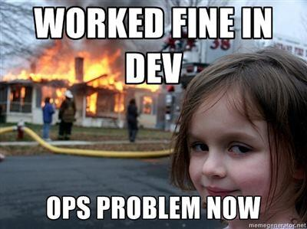

Slide 5
Options ?
Chef
Puppet
Ansible
vRealize Orchestrator
Vrealize Automation
Microsoft SCCM
Notes:
SALTStack anyone using anything else ?
Puppet Ruby like declarative language
How to manage code/scripts

Slide 6
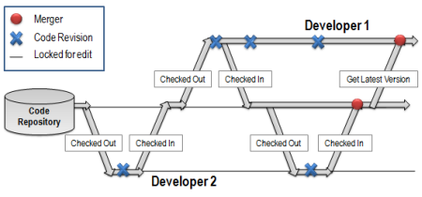
Code Management

Slide 7
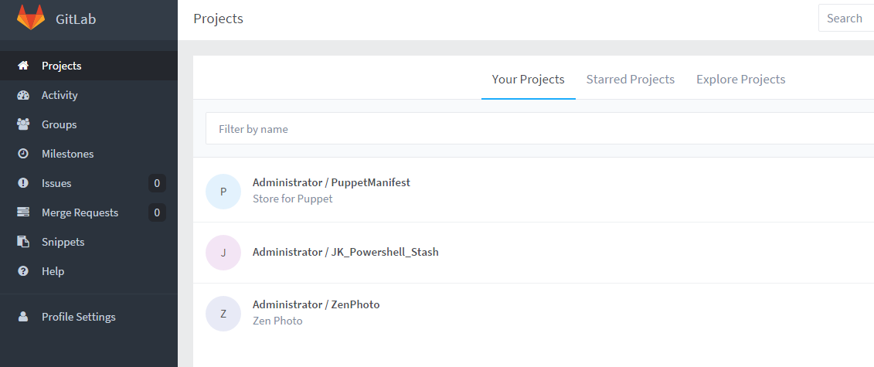
Gitlab
Notes:
Version control code
Allows you to see whats changed by who
Allows you to use CI products GO Jenkins

Slide 8
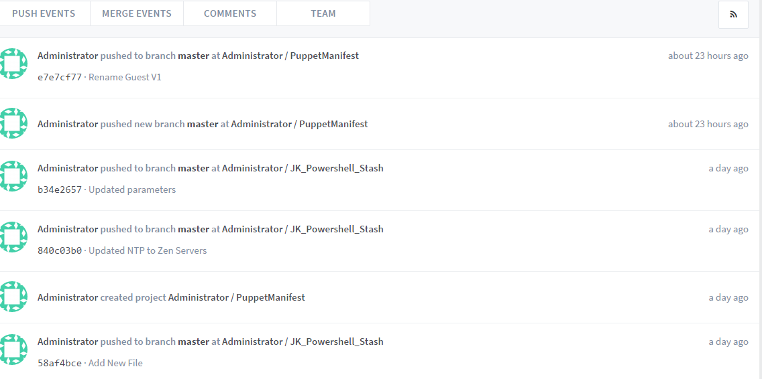
Audit Trail
Notes:
Audit for compliance
Troubleshooting
Especially useful if using any form of CI tool

Slide 9
Puppet by Puppet Labs
Open Source
Free
No Native GUI
Enterprise
Event Inspection
Automatic Discovery
Role Based Access Control
Puppet Performance Reporting
Support
Additional modules
Notes:
Puppet is used elsewhere in the business so good knowledge just not in our division
Enterprise approx. $100 per node per year
Perpetual licence is available
Same core same agents
3,500+ module library. For free
GUI called foreman can be added to Open source

Slide 10
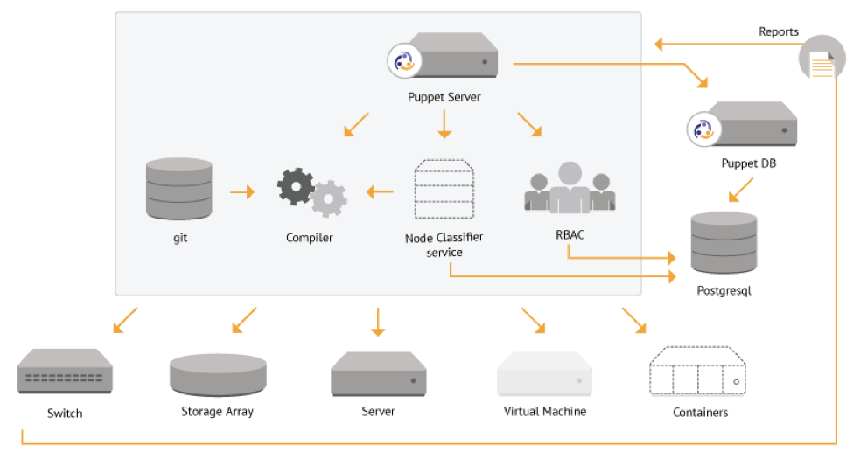
Puppet Architechture
Notes:
Multi master is available for load balancing/resilience

Slide 11
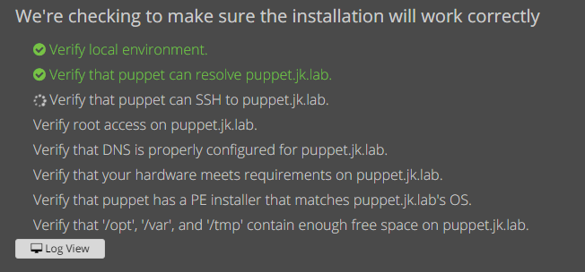
Puppet Installation ( Enterprise)
Notes:
Tried the OS first
Pre req’s and run a webserver to help you install 20 mins install

Slide 12
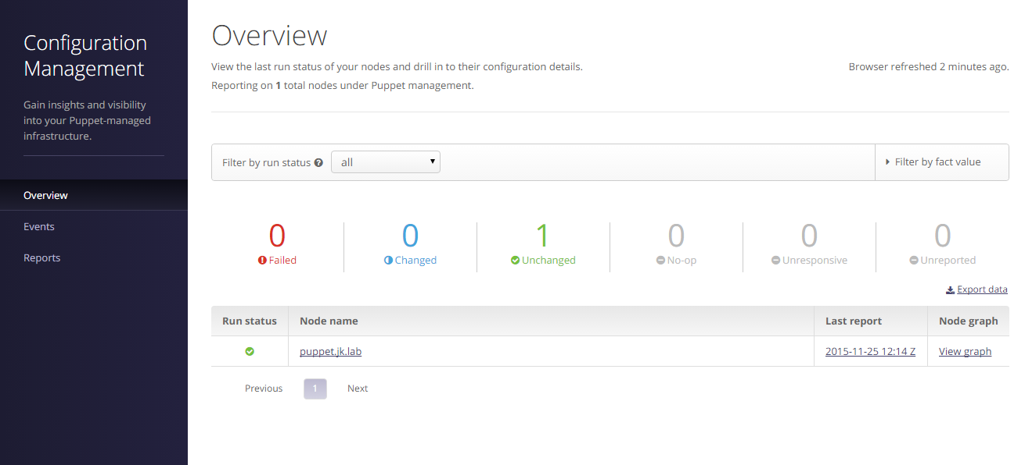
Dashboard
Notes:
Puppet manages itself
First agent deployed
Deploy agents can be done manualy or automated

Slide 13
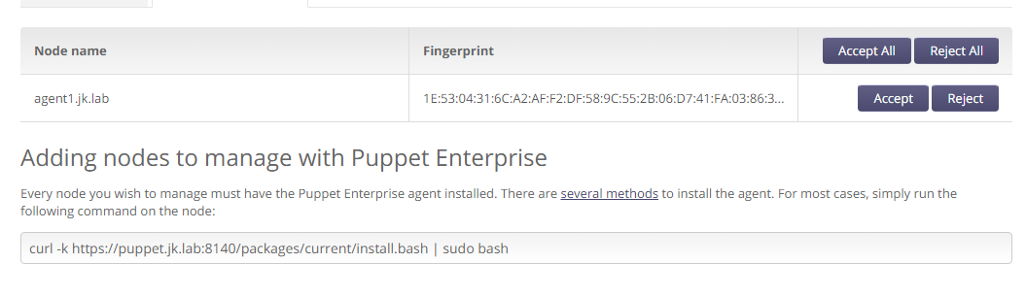
Agent Checkin

Slide 14
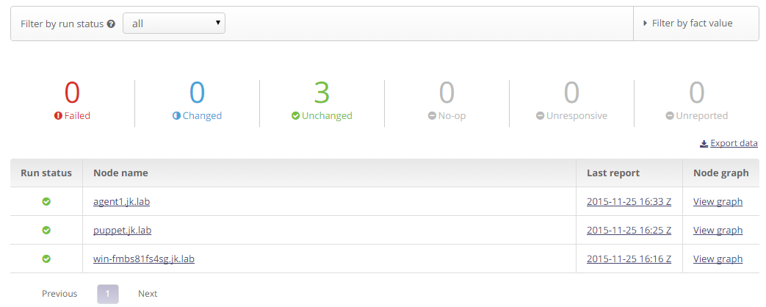
Multiple Agents

Slide 15
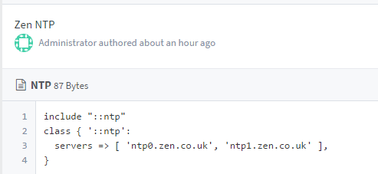
Declarative Language
Notes:
Many classes available

Slide 16
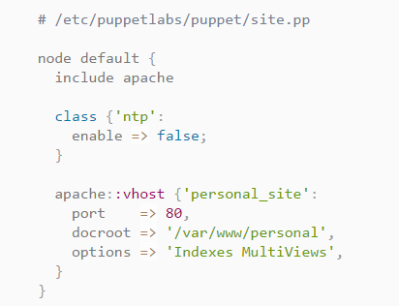
Apache example

Slide 17
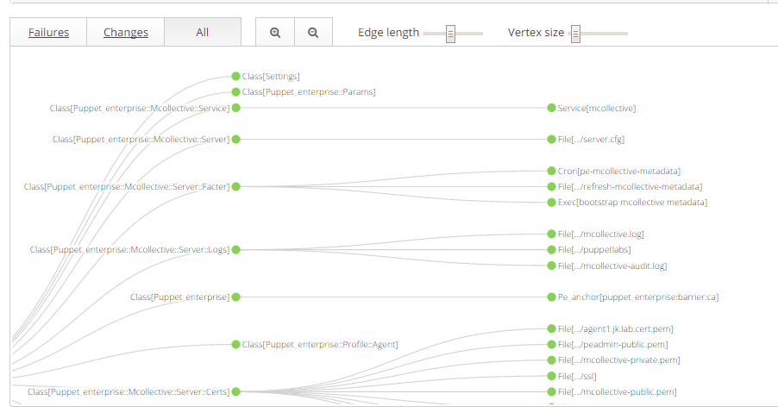
Graph
Notes:
Graph shows successful provision

Slide 18
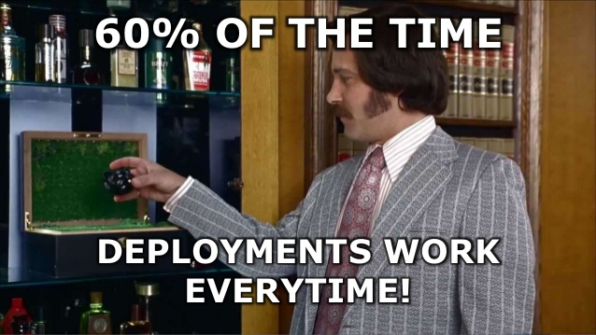
Gotchas
Time Sync
DNS & Reverse DNS
Start Simple
Test changes
Notes:
DNS
Or NTP
Local auth ?
SSH keys ?
Windows
Users AD membership etc
IIS SQL available in forge

Slide 19
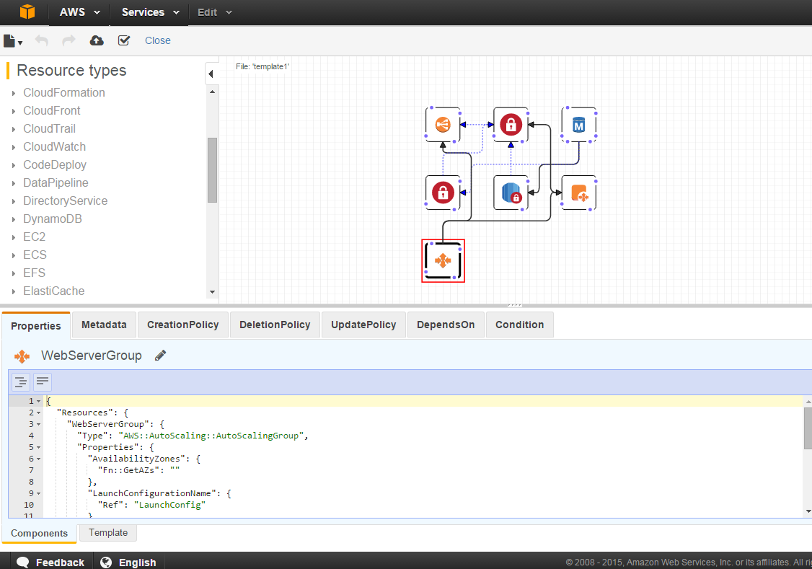
Market is Moving Fast
Notes:
Be able to provide services to your business

Slide 20
Whats Next ?
Fully Automated Provisioning
Multi tenant
Move to Prod….
VMware Host Management

Slide 21
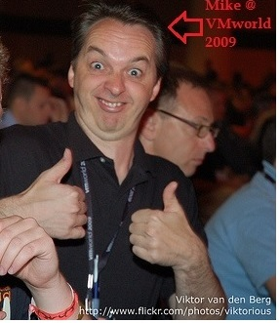
#Feed4orward vmug.com/p/cm/ld/fid=7221
Notes:
Explain Feed4orward

Slide 22
Thank You Any Questions ??
Notes:
Come and talk to me about Automation or vExpert

